Slide 1


Azure NetApp Files
Enterprise Grade File Services
Welsh Azure User Group
20th April 2022

Slide 2




About Me
Worked within the Information Technology industry for more than 20 years​
Currently working as a Cloud Solutions Architect at NetApp in the EMEA Azure Business Group
Focused on Azure, specialising in Azure NetApp Files & Cloud Volumes ONTAP
Anthony MAshford
anthonymashford
blog.mashfords.com
anthonymashford

Slide 3
About Me
Worked within the Information Technology industry for more than 20 years​
Focused on Azure, specialising in Azure NetApp Files & Cloud Volumes ONTAP
Currently working as a Cloud Solutions Architect at NetApp in the EMEA Azure Business Group
First career
Fisherman
anthonymashford
blog.mashfords.com
anthonymashford

Slide 4

About Me
That’s me, there!
Worked within the Information Technology industry for more than 20 years​
Focused on Azure, specialising in Azure NetApp Files & Cloud Volumes ONTAP
Currently working as a Cloud Solutions Architect at NetApp in the EMEA Azure Business Group
Second career
H.M Royal Marines
anthonymashford
blog.mashfords.com
anthonymashford

Slide 5

About Me
Worked within the Information Technology industry for more than 20 years​
Focused on Azure, specialising in Azure NetApp Files & Cloud Volumes ONTAP
Currently working as a Cloud Solutions Architect at NetApp in the EMEA Azure Business Group
Third career
Technology
anthonymashford
blog.mashfords.com
anthonymashford

Slide 6

About Me
Worked within the Information Technology industry for more than 20 years​
Focused on Azure, specialising in Azure NetApp Files & Cloud Volumes ONTAP
Currently working as a Cloud Solutions Architect at NetApp in the EMEA Azure Business Group
Me Having Fun!
anthonymashford
blog.mashfords.com
anthonymashford

Slide 7

Azure NetApp FIles

Slide 8

Challenges

Slide 9




Common Challenges
Cost
Test & Dev
Migration
Scale
Cloud services can typically be more expensive to consume
Testing & Development against production data sets can be challenging
Migration of data sets from on-premises to Azure
Scaling of resources to meet demand

Slide 10
OVERVIEW
“MICROSOFT AZURE NETAPP FILES IS AN AZURE FIRST-PARTY SERVICE SUPPLIED BY MICROSOFT”.

Slide 11
OVERVIEW
Widest choice of file protocols (NFSv3, NFSv4.1, SMB3) in Azure (99.99% SLA)
Most advanced enterprise data management (NetApp® Snapshot™ copies, clones, and replication)
Azure consistent experience, support, and billing–Azure portal, not marketplace!
On-premises-class performance with multiple tiers (standard, premium & Ultra)
Standard
Premium
Ultra
IOPs 1,000 (16K) per 1TiB
--------------------------
Throughput
16MiBps per 1TiB
IOPs 4,000 (16K) per 1TiB
--------------------------
Throughput
64MiBps per 1TiB
IOPs
8,000 (16K) per 1TiB
--------------------------
Throughput
128MiBps per 1TiB
NetApp ONTAP® and flash technology as a fully managed Azure service

Slide 12
Azure Subscription
Azure NetApp Account
US East
Azure NetApp Account West Europe
… up to 10
Azure NetApp Account x
Region x
… up to 10
Capacity Pool 1
Ultra
4 - 500 TiB
Capacity Pool 2
Premium
4 - 500 TiB
Capacity Pool N
Standard
4 - 500 TiB
… up to 25
Up to 12.5 PiB of Enterprise NAS storage under
a single Azure NetApp Account!
Vol 1
100GiB – 100TiB
Vol 2
100GiB – 100TiB
… up to 500
Vol z
100GiB – 100TiB

Slide 13

Performance
Service level | Throughput
Ultra | 128MiB/s per 1TiB quota
Premium | 64MiB/s per 1TiB quota
Standard | 16MiB/s per 1TiB quota
X
=
Service Level
Volume quota
Performance
Example: 50 TiB premium pool performance
50 x 64 MiB/s = 3.2 GiB/s (all-up)
Volume size 10 TiB
Volume performance 10 x 64 MiB/s = 640 MiB/s
NetApp ONTAP® and flash technology as a fully managed Azure service
https://docs.microsoft.com/en-us/azure/azure-netapp-files/azure-netapp-files-performance-considerations

Slide 14
Sizing for Performance – Auto QoS
10 TiB Ultra Capacity Pool Auto QoS (ultra service level = 1280 MiB/s)
1280 MiB/s
Backup
4.5 TiB / 576 MiB/s
Shares
Data
4 TiB / 512 MiB/s
Throughput
Logs
Capacity
10 TiB

Slide 15
Sizing for Performance – Manual QoS
10 TiB Ultra Capacity Pool Manual QoS (ultra service level = 1280 MiB/s)
1280 MiB/s
Backup
4.5 TiB / 256 MiB/s
Shares
Data
4 TiB / 704 MiB/s
Throughput
Select Throughput
Logs
Capacity
10 TiB

Slide 16
Dynamic Volume Shaping - ANF

Slide 17
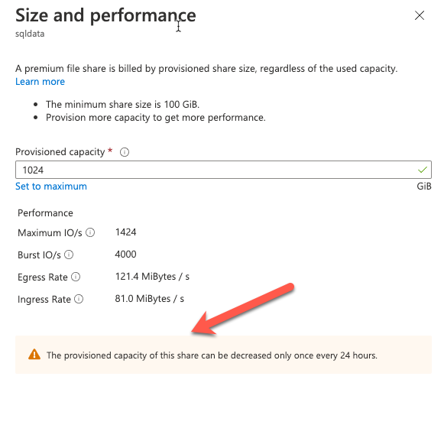
Dynamic Volume Shaping – Azure Files
Azure NetApp Files volumes can be flexed up & down with no limitations
Azure Files can only be decreased once every 24 hours
There are additional charges for snapshots
IO bursts are permitted but they are chargeable

Slide 18
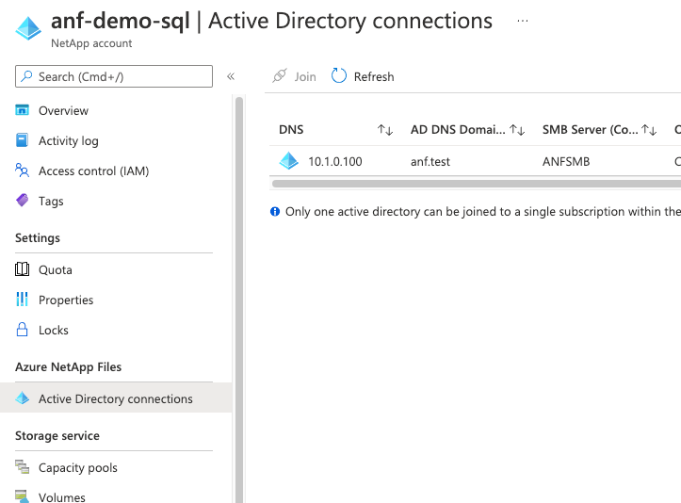
Authentication - ANF
Configuration of an Active Directory connection in Azure NetApp Files is simple and straight forward
The Connection configuration is added within the Azure portal ANF blade
Connectivity is required to Domain Controllers and DNS servers

Slide 19
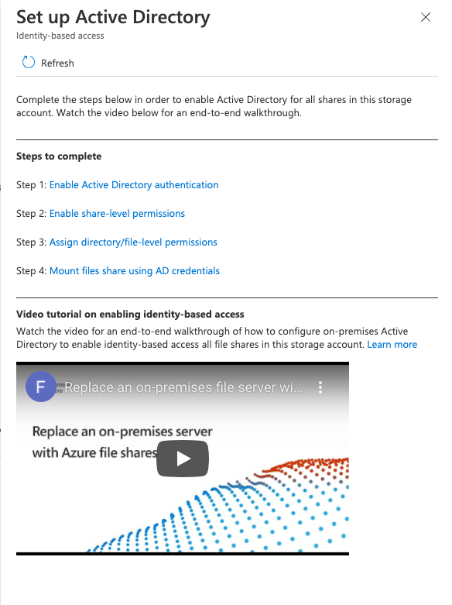
Authentication – Azure FIles
Azure Files File Shares do not by default use Active Directory
There is a huge amount of configuration that needs to be completed
A how-to video is included ☺

Slide 20
Cross Region replication
Source
https://docs.microsoft.com/en-us/azure/azure-netapp-files/cross-region-replication-introduction

Slide 21
Cross Region replication
Asynchronous Replication
Source

Slide 22
Cross Region replication
Asynchronous Replication
Source
Destination

Slide 23
Cross Region replication
Asynchronous Replication
Source
Destination
Replication internals:
10 Minutes – RPO of less than 20 minutes
1 Hour – RPO of less than two hours
1 Day – RPO of less than two days
https://docs.microsoft.com/en-us/azure/azure-netapp-files/cross-region-replication-introduction

Slide 24










Use Cases

Slide 25



demo
Creating an Azure NetApp Files account
Adding a capacity pool
Creating a Volume

Slide 26




Summary
Microsoft Azure NetApp Files let’s you streamline and simplify data migration to Azure by combining new of levels of
Simplicity
Efficiency
Cost
Mobility
Microsoft Azure NetApp Files is a fully managed cloud service

Slide 27


Get Started Today
Login to the Azure Portal
Setup your Microsoft Azure NetApp Files account ​
Add your Capacity Pools
Create your Volumes

Slide 28

Useful links
https://cloud.netapp.com/azure-netapp-files
https://docs.microsoft.com/en-us/azure/azure-netapp-files/whats-new
https://docs.microsoft.com/en-us/azure/azure-netapp-files/azure-netapp-files-register
https://aka.ms/ANF-benchmarks
https://docs.microsoft.com/en-us/azure/azure-netapp-files/azure-netapp-files-solution-architectures
anthonymashford
blog.mashfords.com
anthonymashford

Slide 29
Thank you
anthonymashford
blog.mashfords.com
anthonymashford

